Slide 1
DATA SCIENCE FOR ECONOMISTS
ECON 220 LAB
Jafet Baca-Obando
Week 9, Handling IPUMS Data (Part 2) – 10/24/2025

Slide 2
Outline
01 | IPUMS
02 | Recoding and outlier analysis
03 | Basic sampling

Slide 3
What is IPUMS?
Integrated Public Use Microdata Series​
Operated by the University of Minnesota
Core mission: data harmonization
IPUMS takes datasets that were originally collected with different questions, codes, and variable names and makes them consistent. Lots of recoding!
Free access!​
By providing access to detailed, anonymized individual-level data (microdata), IPUMS allows researchers to ask complex questions that can't be answered with aggregated summary tables.

Slide 4
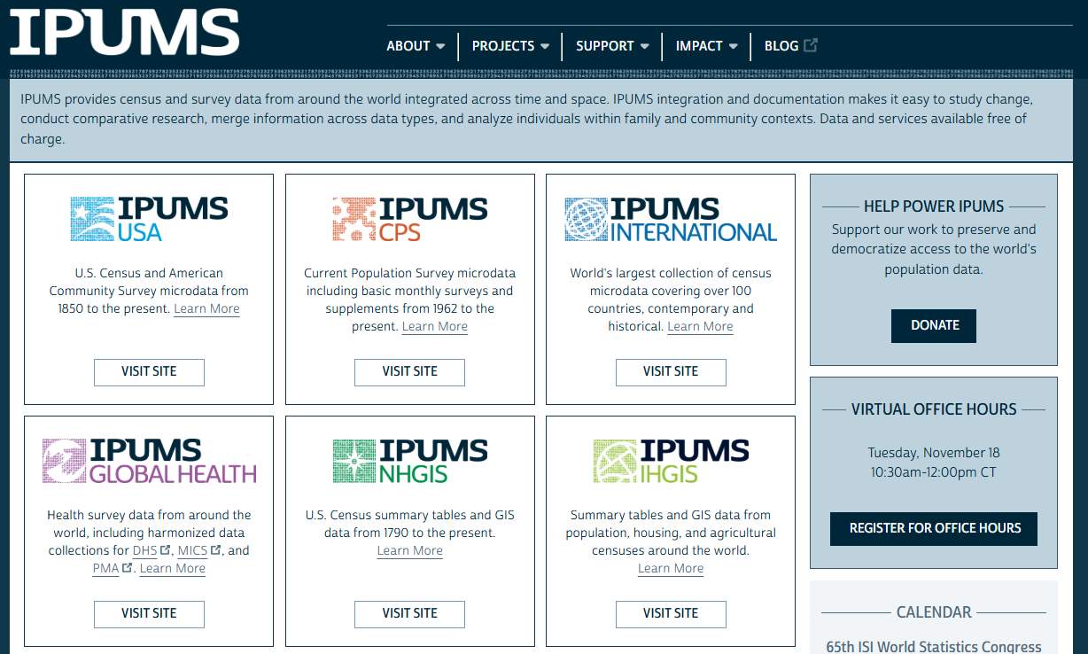
How to register and extract data? Check guide on Canvas.

Slide 5
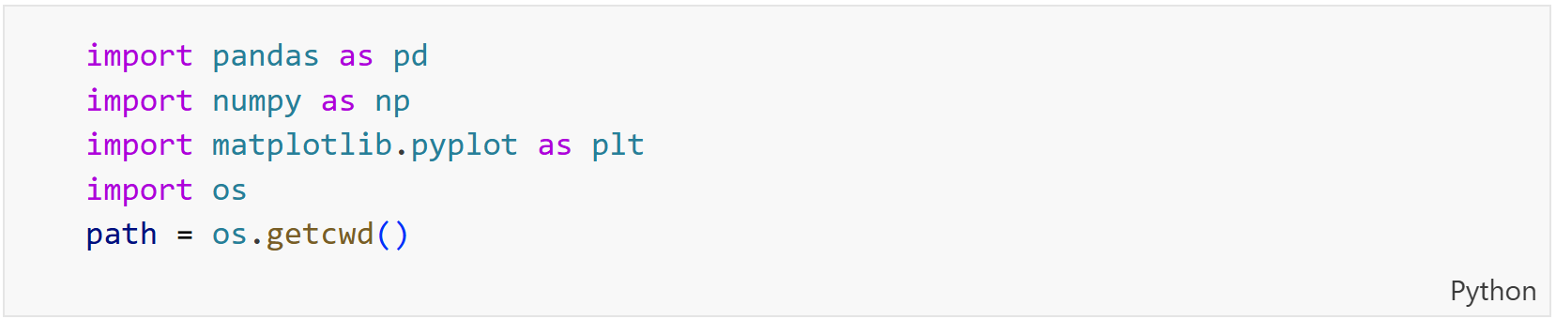
Importing required libraries

Slide 6
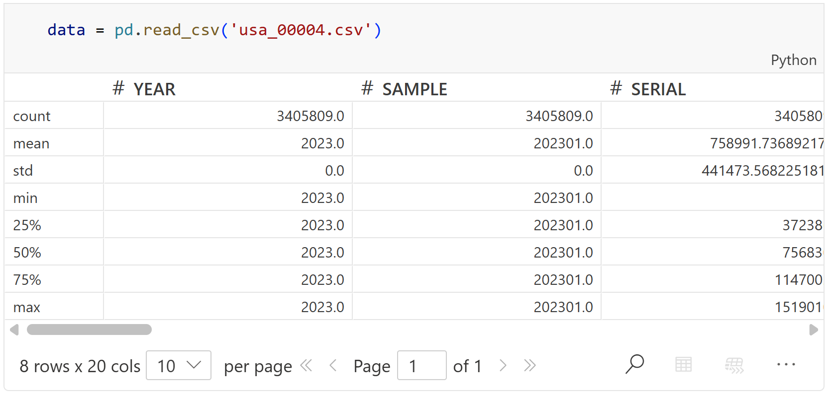
Load and explore the data
Note the large number of observations!

Slide 7
Recoding a categorical variable
IPUMS uses numeric codes for categorical variables.
Example: SCHLTYPE (School Type).
Need the Codebook! Tells us: 0=N/A, 1=Not Enrolled, 2=Public, 3=Private.
Recoding: replace numbers with meaningful labels.

Slide 8
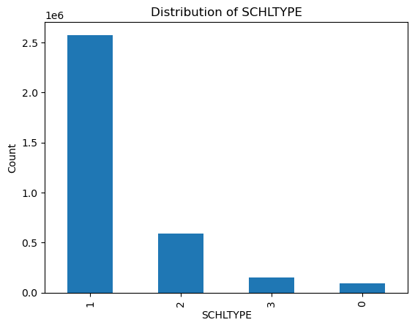
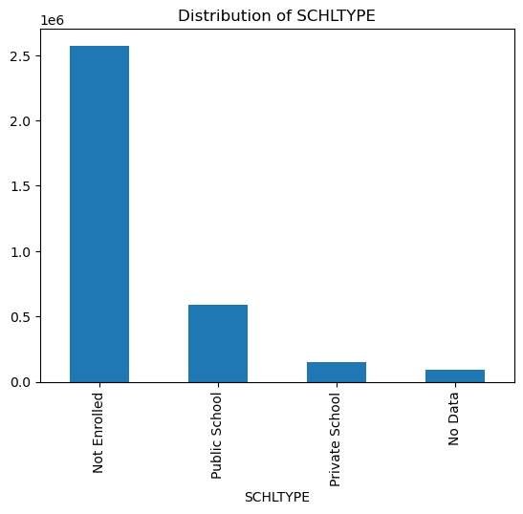
Recoding a categorical variable

Slide 9
Outlier detection and treatment
Outliers: Extreme values that might distort analysis.
Idea:
  Use a histogram (.hist()) to see the distribution.
  Observe asymmetry and potential extreme high/low values (including negative).
Treatment:
  Interquartile range (IQR) =Q3 (75th percentile) - Q1 (25th percentile)
  Define Bounds: Lower = Q1 - 1.5*IQR, Upper = Q3 + 1.5*IQR.
  Filter: Keep data only within these bounds.

Slide 10
Outlier detection and treatment
IQR might not catch all problematic values (e.g., 0 or negative income).
Domain knowledge: Is zero/negative income plausible/useful for this analysis?
Filter: Remove observations with INCTOT <= 0.

Slide 11
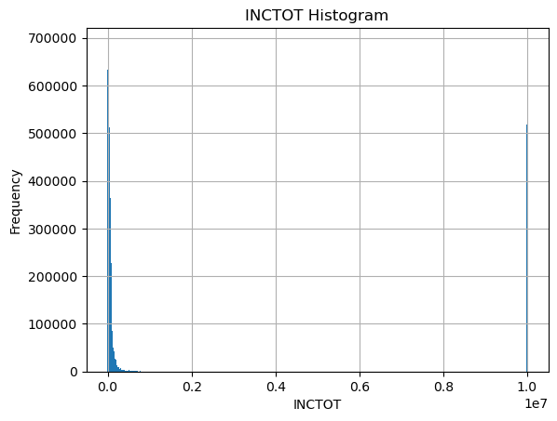
Outlier detection and treatment

Slide 12
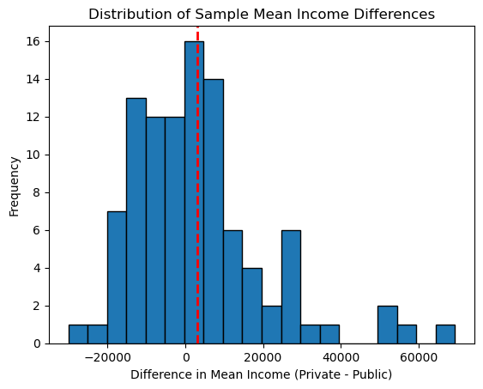
Random sample

Slide 13
Recap
Check the Codebook: It's essential for understanding IPUMS numeric codes.
Recode Variables: Use .replace() to make your data readable (e.g., 2 → "Public School").
Find Outliers: Use .hist() to visualize data and spot extreme values.
Sample for Speed: Use .sample() for quick analysis on large datasets, but be aware of sampling variability.

Slide 14
To-do list
Complete Data Exercise 6
  Upload Jupyter notebook (.ipynb file) and HTML file on October 26
Complete Data Exercise 7
  Upload Jupyter notebook (.ipynb file) and HTML file on November 2

